Slide 1
Testing Process and Types of Testing

Slide 2
Agenda
Software Testing
Testing Process
Software testing and its overview
What are steps involved in testing process
Types of Testing
Explanation
What are the types of testing
Explanation of testing types

Slide 3
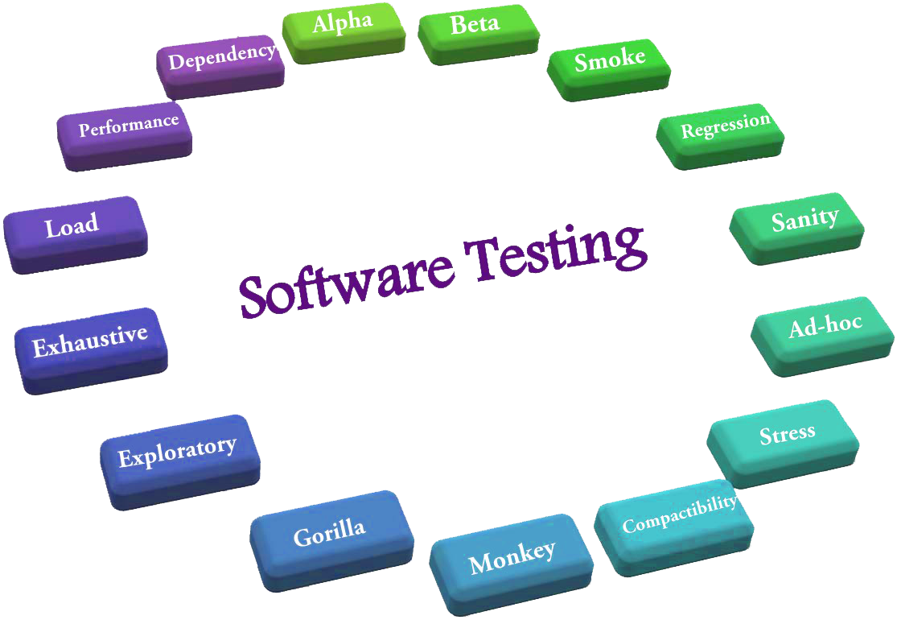
Software Testing
Software testing is the process of evaluating a product to ensure it meets the requirements and to identify errors, missing specifications, and gaps between current and stipulated conditions. It is performed at virtually every software development stage, and often involves executing software manually or with automated tools to make sure it functions properly and provides a good user experience.
Notes:
Software testing ensures that a product meets requirements, is ma hum software ma errors identify krty hain, or is ma hum dekhty hain k humara software specified conditions meet krra hai ya like, conducted at various development stages through manual or automated execution for optimal functionality and user experience.
Ab testing ko perform kese kiya jata hai konsy steps involve hoty hain wo hum dekhen gy

Slide 4
Testing Process
Software testing process involves several key steps, including Requirement Analysis, Test Planning, Test Design, Environment Setup, Test Execution, and Test Closure, each contributing to the overall assurance of software quality.
1. Requirement Analysis: Identifying, documenting, and analyzing user needs and system specifications to establish the foundation for testing activities.
Notes:
Is k bad hum testing process dekhy gy k ek software ko test krny k liye konsy steps involve hoty hain
In Requirement Analysis phase, test team studies the requirements and identify the testable requirements.

Slide 5
Testing Process (cont)
2. Test Plan: A comprehensive document outlining the scope, approach, resources, and schedule of testing to ensure systematic and organized testing processes.
3. Test Design: Creating detailed test cases and test scripts based on the test plan to guide the execution and validation of the software.
Notes:
Test Plan: In this phase the Test Manager or Test Lead prepares the Test Plan and Test strategy documents. K konsi testing approach use krni etc Test Design: In Test design phase, testers prepare test scenarios, test cases and test data based on the Requirement Documents and Test Plan.

Slide 6
Testing Process (cont)
4. Environment Setup: Configuring the testing environment to replicate the production system, ensuring accurate and realistic testing conditions.
5. Test Execution: Running the test cases in the designated environment, detecting defects, and verifying whether the software meets specified requirements.
Notes:
Environment setup: It is a combination of hardware and software environment on which the tests will be executed.
Test Execution: In Test Execution phase the test cases are executed in the testing environment, while execution of the test cases the Testing team may find bugs which will be reported, bugs are fixed by the developer and they are retested by the Testing Team
Activities: a) Execution of Test Cases b) Document test results, and log defects for failed cases

Slide 7
Testing Process (cont)
6. Test closure: Finalizing the testing phase by evaluating results, generating reports, and formally closing the testing process, summarizing findings and lessons learned.
Notes:
Testing team will meet, discuss and analyze testing artifacts and evaluate Test cycle completion criteria. Identify strategies that have to be implemented in future and taking lessons from the current test cycle. 1. Prepare Test closure report 2. Test metrics

Slide 8
Testing Types

Slide 9
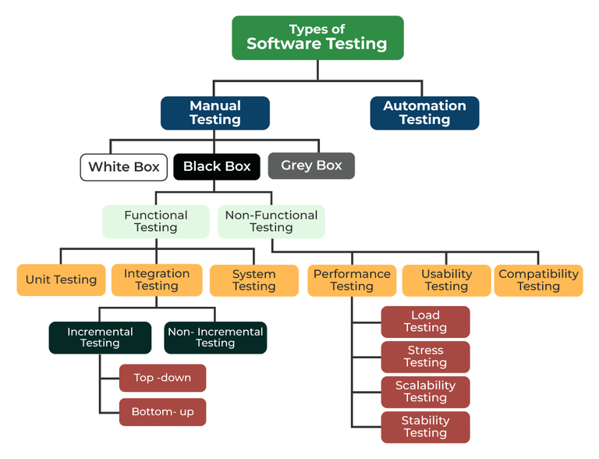
Notes:
Ye testing ki types hain

Slide 10
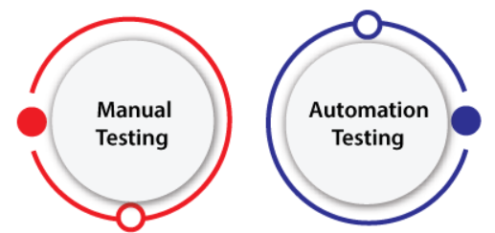
Types

Slide 11
Manual Testing
Manual Testing.
It is a procedure of verification and validation. Manual testing is used to verify the behavior of an application or software in contradiction of requirements specification.
Notes:
We do not require any precise knowledge of any testing tool to execute the manual test cases.

Slide 12
Types-Manual Testing
Blackbox testing:
Assessing the functionality of a software system without knowledge of its internal implementation.
Whitebox testing
Examining the internal logic and code of a software system for thorough assessment.
Notes:
Blackbox ma andr ki detail yani code ka logic pta hona laazmi ni hota non technical b isko test kr skta whitebox ma sara logic or function tester ko pta hota

Slide 13
Types-Blackbox Testing
Functional Testing
Non-Functional Testing

Slide 14
Functional Testing
Unit Testing
Unit Testing is a type of software testing which is done on an individual unit or component to test its corrections. Typically, Unit testing is done by the developer at the application development phase. Each unit in unit testing can be viewed as a method, function, procedure, or object.

Slide 15
Integration Testing
Integration testing is a type of software testing where two or more modules of an application are logically grouped together and tested as a whole. This type of testing is done on integrating modules of a system or between systems.
Notes:
For example, a user is buying a flight ticket from any airline website. Users can see flight details and payment information while buying a ticket, but flight details and payment processing are two different systems. Integration testing should be done while integrating of airline website and payment processing system.

Slide 16
System Testing
System testing is like checking if the entire computer program works as it should. It's done to make sure that all the different parts of the software play well together and meet the requirements. This testing phase looks at how the program functions, how easy it is to use, and whether it's reliable and performs well. The goal is to catch any issues before the software is used in the real world.

Slide 17
Non-Functional Testing
Performance Testing
Performance testing is like checking if a computer program can handle its job without slowing down or crashing. It involves testing how fast and stable the software is under different conditions, like a lot of people using it at the same time. The goal is to make sure the program works smoothly and meets expectations when it's put to the test.

Slide 18
Usability Testing
Usability testing is like checking how easy and user-friendly a website, app, or software is for people to use. It involves observing real users as they interact with the product to see if they can complete tasks easily and intuitively. The goal is to identify any design or navigation issues that might make the user experience less enjoyable or efficient. Usability testing helps ensure that the product is user-friendly and meets the needs of its intended audience.

Slide 19
Compatibility Testing
Compatibility testing is like checking if a computer program plays nice with different devices and systems. It's making sure the software works well and looks good, whether you're using it on a laptop, a phone, or with different browsers. The goal is to catch any problems that might pop up when people use the software in different ways. Compatibility testing ensures a hassle-free experience for users, no matter what device or system they're using.

Slide 20

Questions?

Slide 21

Thank you

